Slide 1


Top Songs from 2010-2019
Hemin Patel
Data 101

Slide 2
Why Study Song’s Audio Features?
This data can be used to explore trends in the popularity of music genres.
Can use the attributes, like BPM, and incorporate them into new songs, possibly the next Billboard hit song.
Can predict future a song’s popularity with audio features and metadata.
Kaggle Dataset Link
Data 101

Slide 3
Dataset
Kaggle Dataset Link
Clean dataset with 13 rows and 100 columns
Description: The top songs by year in the world by Spotify. This dataset is based on Billboard’s data and has several variables about the songs.
Attributes:
Title
Artist
Top Genre
Year
BPM
Energy
Danceability
Loudness (dB)
Valence
Duration (sec)
Acousticness
Speechiness
Popularity
Data 101

Slide 4
Attributes
BPM – Beats Per Minute - The tempo of the song.
Energy - The energy of a song; the higher the value, the more energetic.
Danceability – Describes how suitable a track is for dancing; the higher the value, the easier it is to dance.
Loudness (dB) – The loudness level in decibels, higher the value, the louder the song
Valence - A measure of musical positiveness of the track. The tracks with the highest number give a sense of positive moods.
Duration (sec) - The duration of the song in seconds.
Acousticness - A measure of how acoustic the track is.
Speechiness - The higher the value that tells how many spoken words were in the track.
Popularity - The higher the value, the more popular the song is.
Data 101

Slide 5
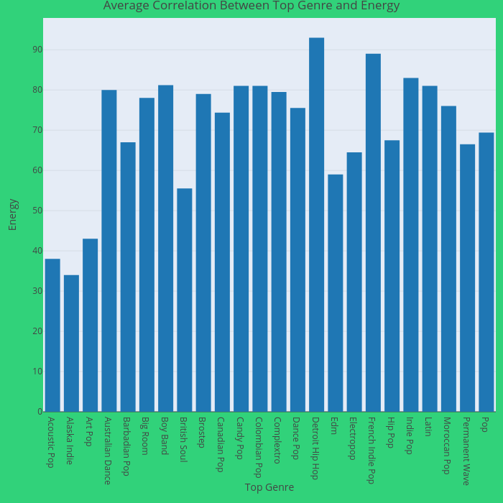
Top Genre v. Energy
Songs in the Detroit Hip Hop genre have more energy in their songs.*
Following are songs in French Indie Pop genre.*
Interactive Plot Link
*Most of these genres only have one point.
Data 101
Notes:
# Top Genre vs Energy
library(plotly)
aggregate(Energy ~ `Top Genre2`, data = top10s, FUN= mean)
k <- aggregate(Energy ~ `Top Genre2`, data = top10s, FUN= mean)
write.csv(k,'AggregateData.csv')
agg_top10s <- read.csv("~/Desktop/Data 101/HW 2/AggregateData.csv")
Energy2 <- agg_top10s$Energy
fig <- plot_ly(x = c(Top.Genre2), y = c(Energy2), width = 700, height = 700, type = 'bar')%>%
layout(title= list(text = "Average Correlation Between Top Genre and Energy",font = "Times New Roman"), font="Times New Roman",
xaxis = list(title = list(text ='Top Genre', font = "Times New Roman")),
yaxis = list(title = list(text ='Energy', font = "Times New Roman")),
plot_bgcolor='#e5ecf6', paper_bgcolor='#31d27a')
api_create(p=fig, filename = "Top Genre vs Energy")
fig

Slide 6
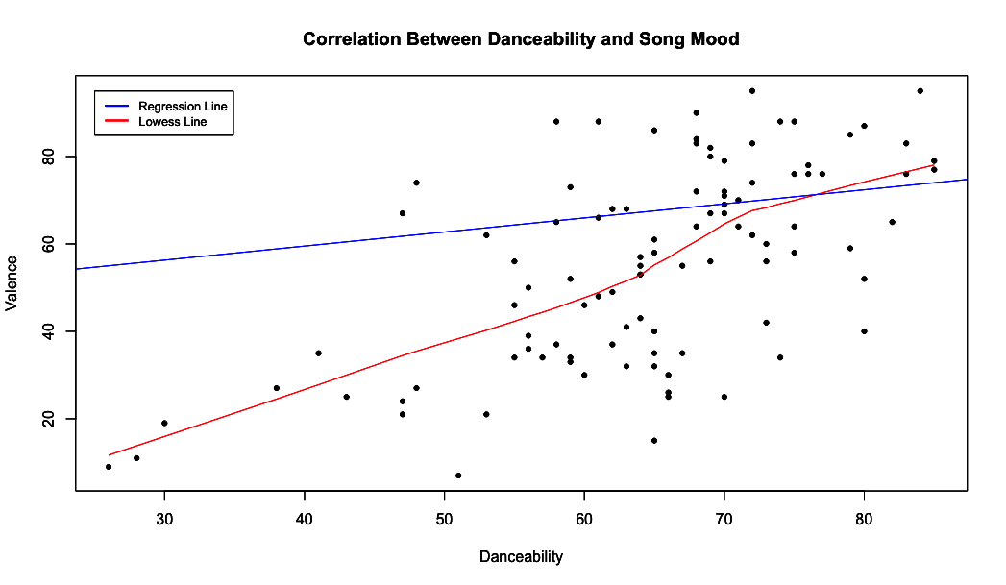
Popular Genres
Regression: relation between one dependent variable and another one.
Lowess: a mean value to identify relationships between variables.
Multiple data points are at 71(D) and 64(SM)*
Song mood value around 64 and has a higher correlation with danceability value.
Overall, song mood does affect danceability. The higher the song mood, the more the danceability value will be.
*D = Danceability SM= Song Mood
Data 101
Notes:
#Valence vs Danceability
attach(top10s)
plot(Danceability, Valence, main = "Correlation Between Danceability and Song Mood",
xlab= "Danceability", ylab= "Valence", pch=20)
lines(lowess(Danceability, Valence), col="red") #lowess line
abline(lm(Danceability~Valence), col="blue") #regression line
legend (x= 25, y=95, c("Regression Line", "Lowess Line"), cex= .8, col= c("blue", "red"), lwd= c(2,2))
par(bg = "transparent")

Slide 7
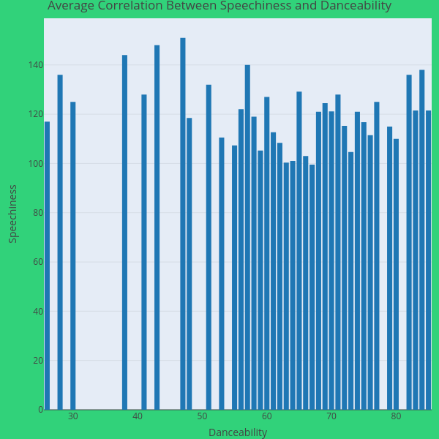
Speechiness v. Danceability
The song with the highest danceability value has a speechiness value of 121.5.
It is apparent that songs with a higher danceability value have a speechiness value of over/ around 100.
Interactive Plot Link
Data 101
Notes:
#Speechiness vs Danceability
library(plotly)
aggregate(BPM ~ Danceability, data= top10s, FUN= mean)
b<- aggregate(BPM ~ Danceability, data= top10s, FUN= mean)
write.csv(b, 'agg_BPM_D.csv')
agg_BPM_D <- read.csv("~/Desktop/Data 101/HW 2/agg_BPM_D.csv")
BPM2 <- agg_BPM_D$BPM
Danceability2 <- agg_BPM_D$Danceability
fig <- plot_ly(x = c(Danceability2), y = c(BPM2), width = 600, height = 600, type = 'bar')%>%
layout(title= list(text = "Average Correlation Between Speechiness and Danceability",font = "Times New Roman"), font="Times New Roman",
xaxis = list(title = list(text ='Danceability', font = "Times New Roman")),
yaxis = list(title = list(text ='Speechiness', font = "Times New Roman")),
plot_bgcolor='#e5ecf6', paper_bgcolor='#31d27a')
api_create(p=fig, filename = "Speech vs Dance")
fig

Slide 8
Conclusion
To create a hit song, the song should be in the Pop genre*
The energy of the song should be upbeat rather than slow.
The valence of the song should also be higher to influence the danceability of the said song.
According to the data, speechiness of a song has little to no effect on danceability.
The data that displays a lower danceability value at the beginning of the graph can be considered outliers that have been affected by the other attributes, such as music genre.
*According to the data from HW1
Data 101

Slide 9


